Slide 1

B Team – Group Assignment
Spark
Group B: Albin S., Daniel R., Tomas F., Jorge R., Nicolas G., & Ckalib N.
Notes:
Hi, my name is Ckalib Nelson and I am a member of Group B, which includes Albin, Daniel, Tomas, Jorge, and Nicolas. Today, we will discuss our Spark Group Assignment about eating habits in Europe.

Slide 2

Table Of Contents
Business Problem
Business Objective
Mission
Analysis
Business Questions
Conclusions
Closing Remarks
Analytical Workflow
Notes:
Group B will discuss several items in this presentation. First, we will discuss the business problem and business objective. Before our closing remarks, we will touch on the mission and dive deep into our data analysis.

Slide 3

Business Problem
ACME Corporation is trying to understand eating habits in different European countries and given that they don’t have any team able to do data analysis, they are asking Professor Raul Marin for help.
Notes:
As indicated by the project prompt, ACME Corporation is trying to understand eating habits in different European countries and given that they do not have a team able to do data analysis, Professor Raul has asked us to help!

Slide 4

Business Objective
Professor Raul Marin has asked Group B to answer several business questions on behalf of ACME Corporation.
Notes:
Thus, our business objective is to answer several business questions on behalf of ACME Corporation.

Slide 5

Mission
The global dataset from ACME Corporation has been segmented into countries and Group B worked on a particular subset to get insights that help ACME plan to make European citizens healthier and let them live longer than 100 years.
Notes:
The mission is to assist ACME Corporation in their efforts to make European citizens healthier and let them live longer than 100 years!

Slide 6

Business Questions
Find the oldest and newest product
Find the average product age, where age means how long the product has been in the system
List of other countries where products are sold too
Identify category of products and the compute
Number of products by category
List containing names of products by category
Identify traces and compute
Number of products by trace
List containing names of products by trace
Data quality analysis on fields of interest (see appendix 1)
Number of products with complete info
% of products without complete analysis per 100g
% of products without additives info
% of products without traces info
Data profiling on fields of interest (see appendix 1)
Stats on analysis per 100g fields
Determine how healthy the different products are. In order to come up with this conclusion, use an official health organism (ex. NHS)
Notes:
Here is the list of business questions and inquiries we have been asked to address for ACME Corporation. They include analysis regarding the age of the products, categories of products, and nutritional profiles.

Slide 7

Analysis
Notes:
Here is where we will begin our discussion on the coding required to complete the aforementioned analysis.

Slide 8
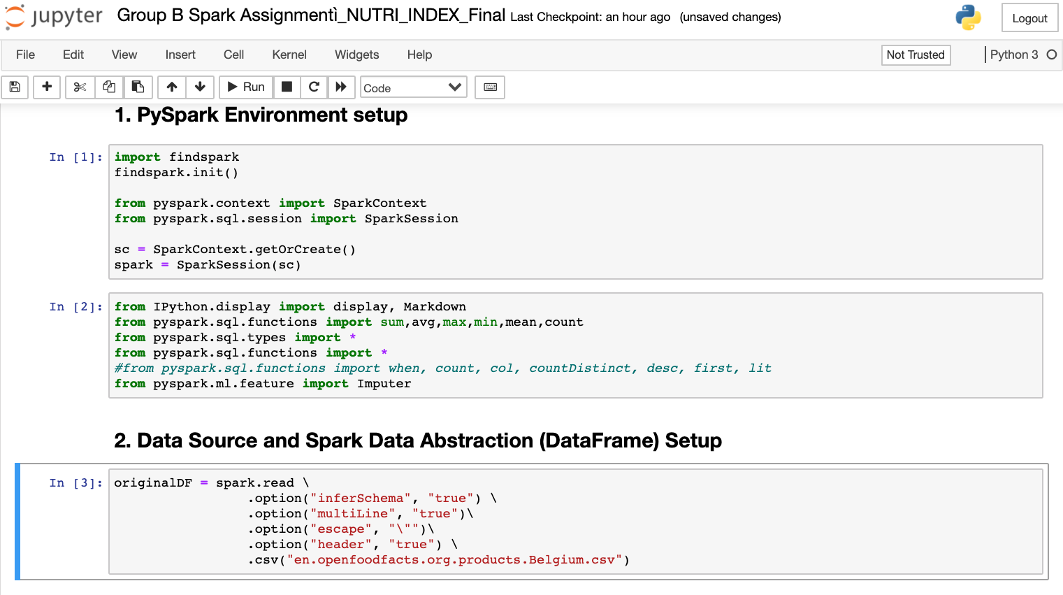
PySpark Environment
PySpark Environment Setup
Data Source and Spark Data Abstraction (DataFrame) Setup
Notes:
Here is where we setup our PySpark Environment with the relevant libraries and functions to complete our analysis. Secondly, we read the data provided to us as a data frame for ease-of-use. This is most likely similar the beginning of everyone else’s code and resembles code used to complete several of the forums!

Slide 9
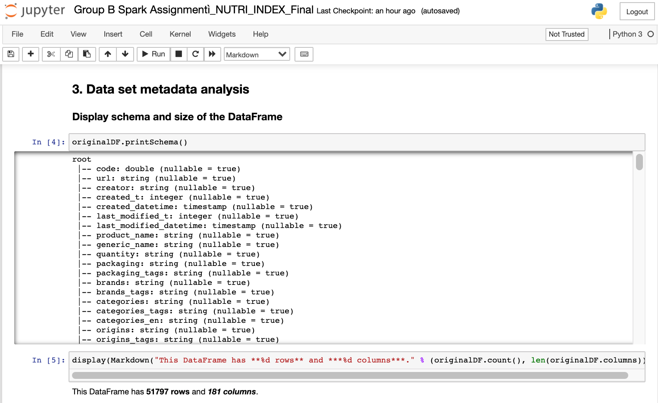
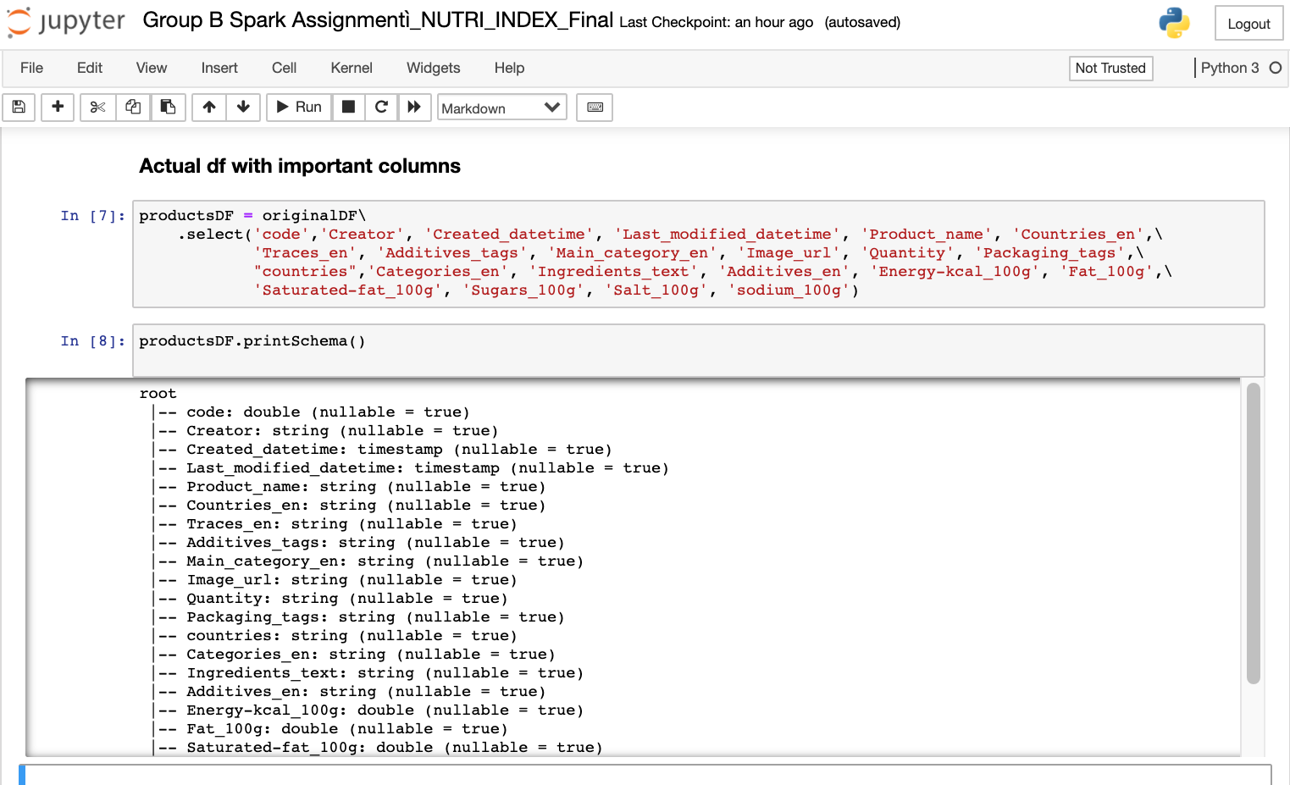
Dataset Metadata Analysis
Notes:
Most analyses should start with a high-level understanding of the data in use. Here, we execute code for a metadata analysis that informs us about the number of rows, columns, column types, and column names.

Slide 10
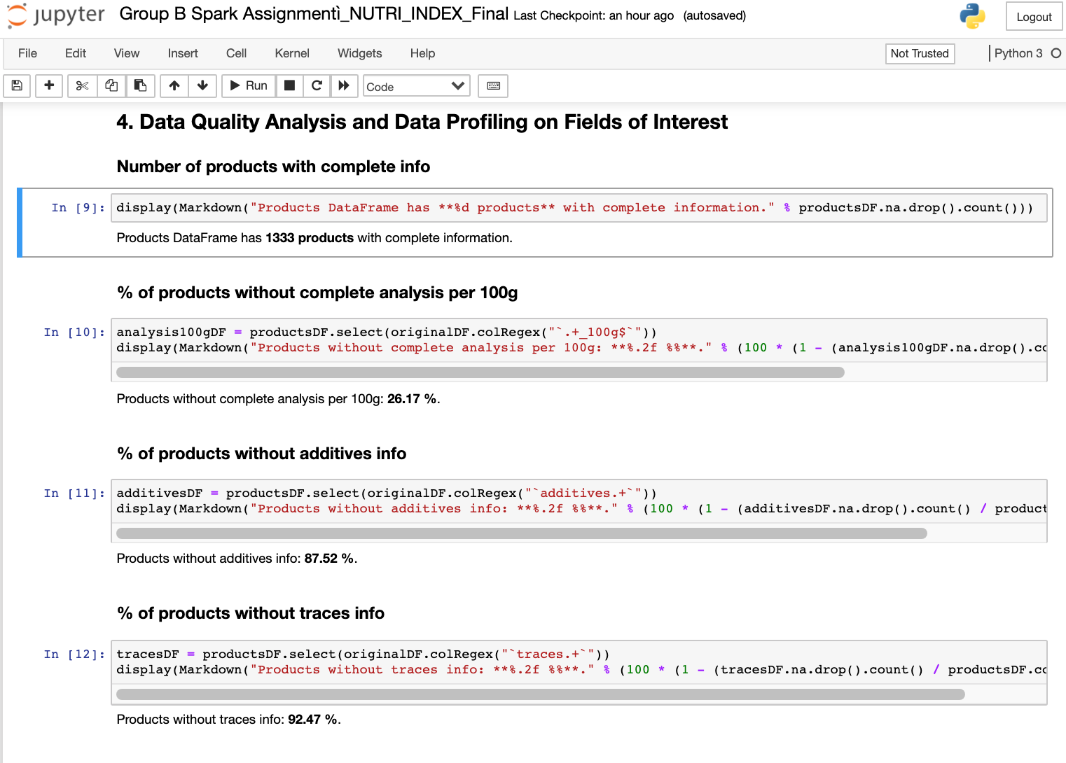
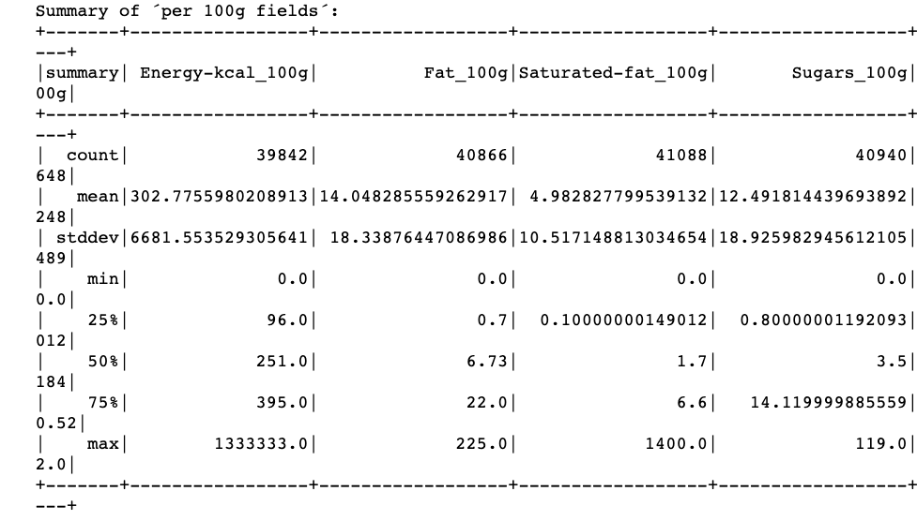
Data Quality Analysis and Data Profiling on Fields of Interest
Data Quality Analysis
Data Profiling on Fields of Interest
Notes:
Following the metadata analysis, we execute code to address several of our business questions/inquiries: what is the number of products with complete information, what percentage of products are without complete analysis per 100g, what percentage of products are without additives information, what percentage of products are without traces information, and a summary profile on 100g fields. A few highlights from this analysis is that a quarter of products are without complete analysis per 100g and that there are several nulls within the 100g fields. Unfortunately, we are working with an imperfect dataset.

Slide 11
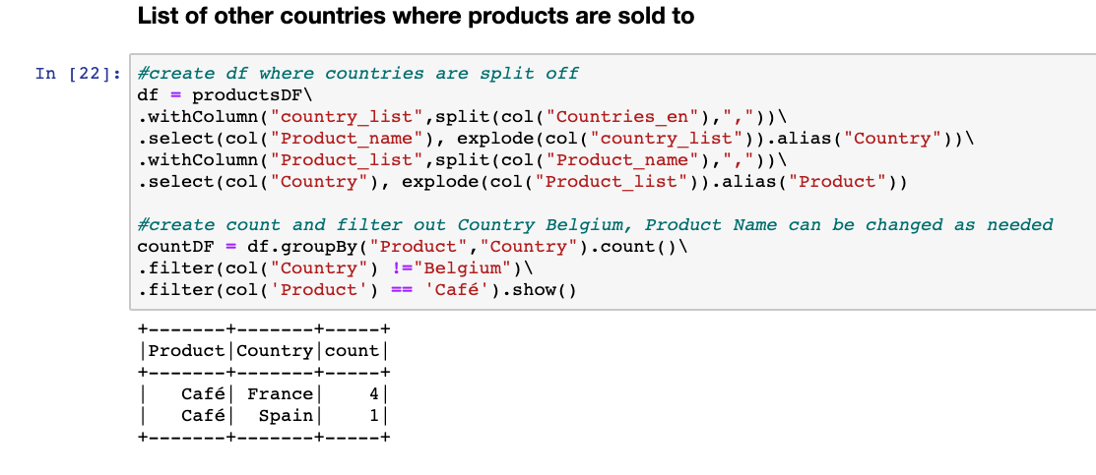
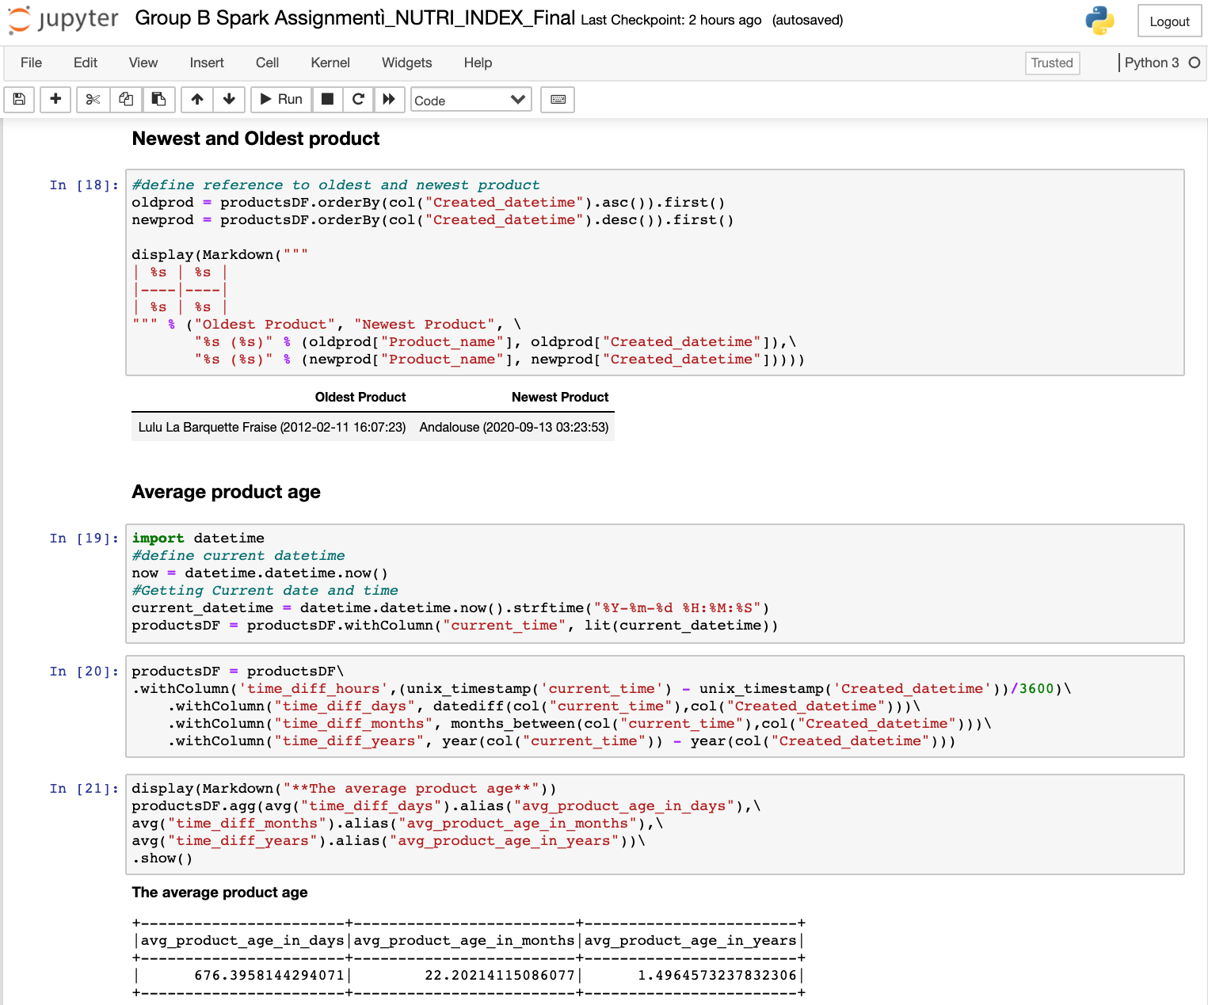
Product Investigation
Other countries where products are sold
New & Oldest Products and Average Product Age
Notes:
Per our analysis, there are a couple other countries where products are sold. Additionally, the oldest product has a date of 2012 whilst the newest product has a date of 2020. Additionally, the average product age is roughly 679 days, 22 months, or 1.5 years at the time of this analysis. The oldest products were created on 15th December 2018.

Slide 12
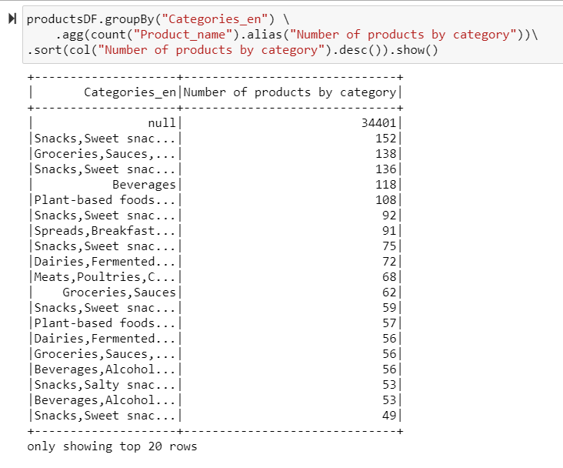
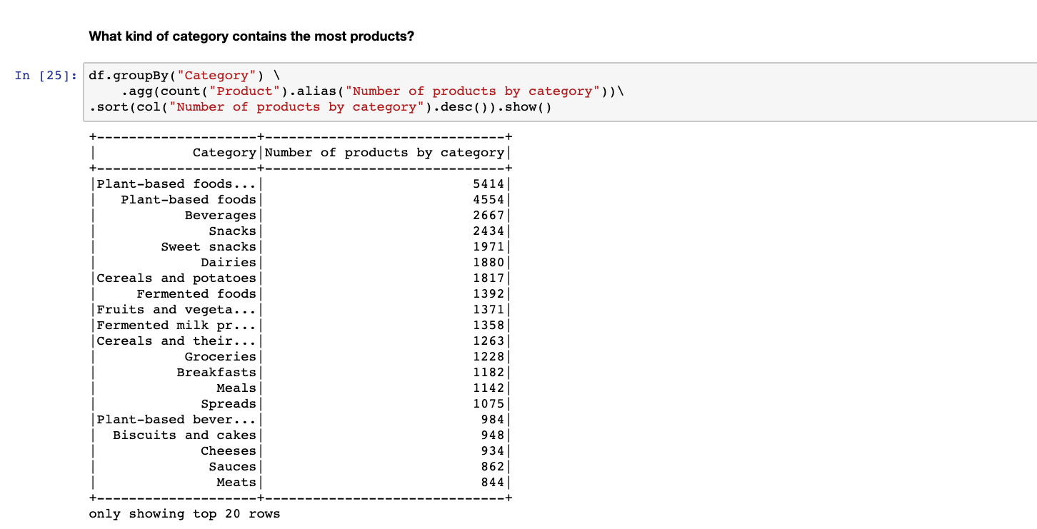
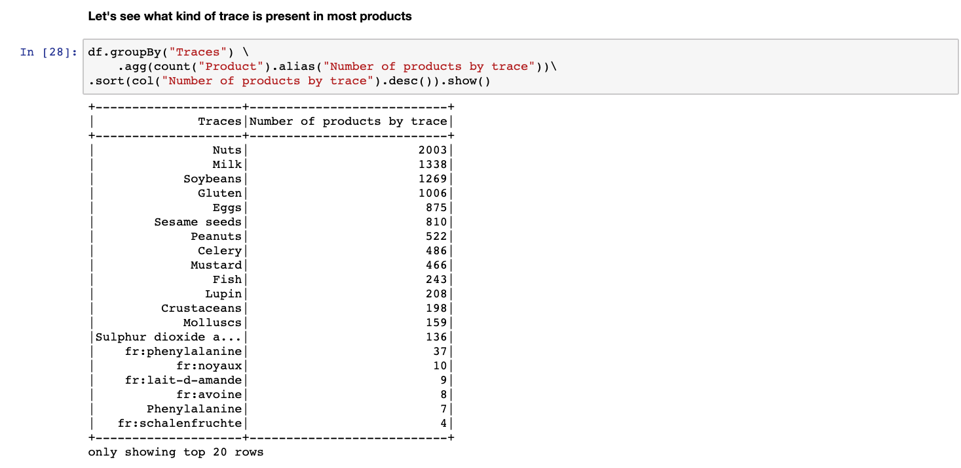
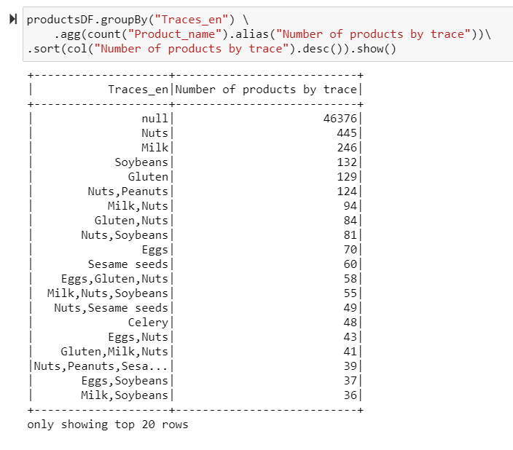
Product Investigation
Identify category of products
Identify traces in products
Notes:
Per our analysis, most products have a category of Plant based foods, beverages, and snacks. Furthermore, most products have a trace of Nuts, Milk, and Soybeans. As we will discuss in our conclusions, several of these categories are quite conducive to having a healthy diet!

Slide 13
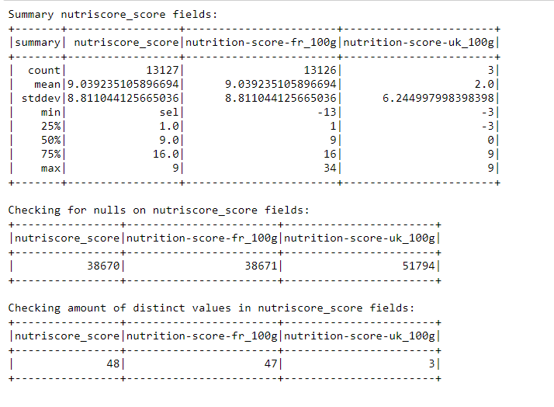
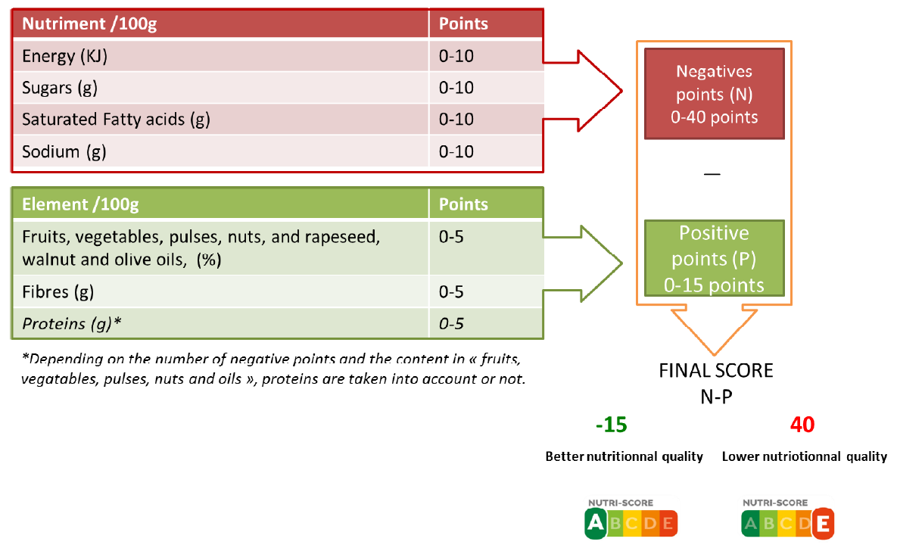
Is the food healthy?
Nutri-score
Do we have this measure in our DS?
Source:https://www.health.belgium.be/sites/default/files/uploads/fields/fpshealth_theme_file/20190902_shc-9284_fbdg_vweb.pdf
Notes:
We do have a Nutritional Index,

Slide 14
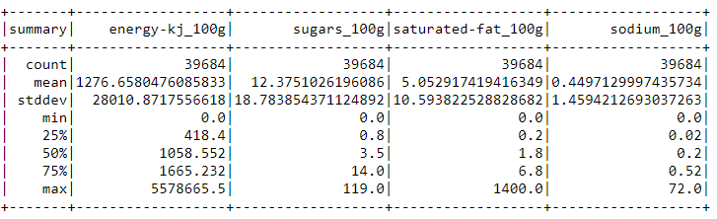
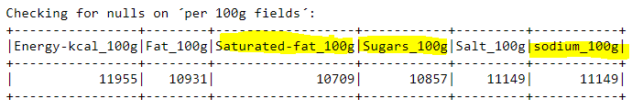
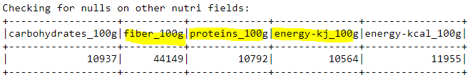
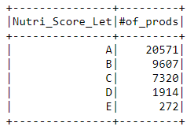
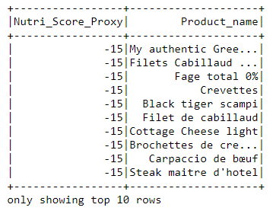
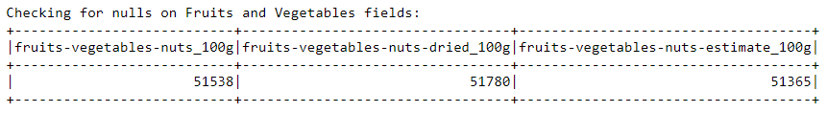
Is the food healthy?
Nutriscore
Do we have the nutrient information we need?
Notes:
We do have a Nutritional Index,

Slide 15

Conclusions
To help ACME plan to make European citizens healthier and let them live longer than 100 years, we think it’s best to…
Adhere to our nutrition scores and eat foods with the most favorable scores
Consume colorful foods, such as vegetables, fruits, and nuts, as they tend to be the healthiest with high amounts of protein and energy. Foods with favorable protein and energy scores should take place in diets more so than foods without such elements
Follow the recommendations from the scientific community, who confirms that if we have the following eating habits, we will live long lives!
Eat more nuts
Avoid overeating
Eat plenty of healthy plant foods
Drink coffee or tea
Notes:
Improv

Slide 16

Additional Sources
Healthy diet by the World Health Organization
Healthy Eating for a Healthy Weight by the Centers for Disease Control and Prevention
Eat Well by NHS
Notes:
Improv

Slide 17
Thank You
Notes:
Improv

